Slide 1
Lesson objective
PBiS Focus
Respect (hands up)
Achieve (stay on task)
Continuing yesterday’s lesson.
Aim:
Divide a given quantity into two parts in a given part : part or part : whole ratio.
Express the division of a quantity into two parts as a ratio

Slide 2
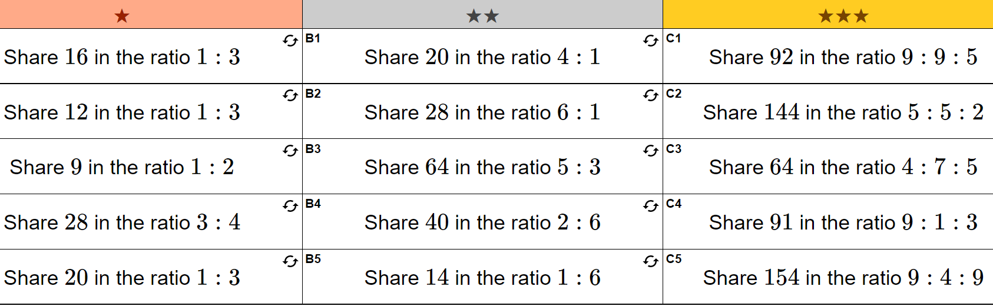

Slide 3
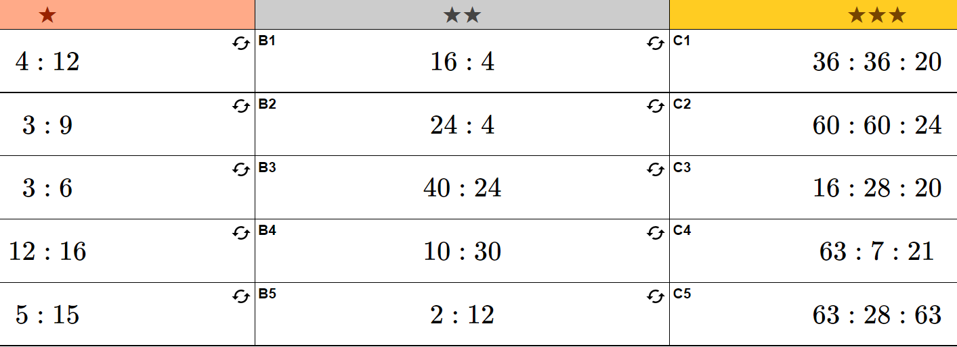

Slide 4
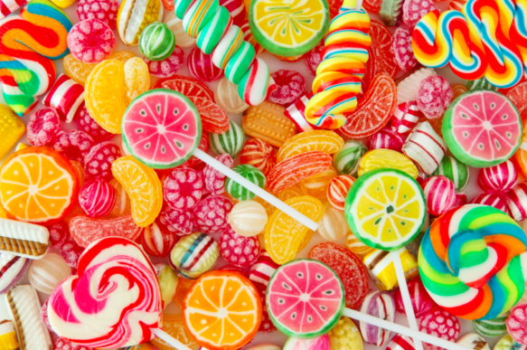
Ratio sharing contexualised question
Paul and Katie share some sweets in the ratio 3:8
Katie gets 32 sweets.
How many sweets does Paul get?
P : K
32
8
=4
3 : 8
12
: 32
3 x 4 = 12
Notes:
Guide
P: K
3: 8
?: 32
X4 so = 12

Slide 5

Ratio sharing contexualised question
Sandra has a piece of string 150cm long.
She cuts the string into three lengths in the ratio 5:2:3
Work out the length, in cm, of each piece of string.
5 : 2 : 3
=10 parts
150
10
= 15
=150cm
75 : 30 : 45
5 x 15 = 75
Notes:
Guide

Slide 6

Ratio sharing contexualised question
Pat and Julie share some money in the ratio 2:5
Julie gets £45 more than Pat.
How much money did Pat get?
5 – 2 = 3
45
3
P : J
= 15
2 : 5
30 :
2 x 15 = 30
Notes:
Guide

Slide 7
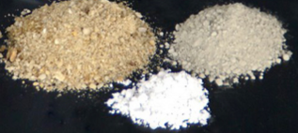

Ratio sharing contexualised question
Talil is going to make some concrete mix.
He needs to mix cement, sand and gravel in the ratio 1:3:5 by weight.
Talil wants to make 180 kg of concrete mix.
Talil has 15kg of cement, 85kg of sand, 100kg of gravel
Does he have enough cement, sand and gravel?
C : S : G
= concrete
180
9
= 20
1 : 3 : 5
= 9 parts
1 x 20 = 20
3 x 20 = 60
5 x 20 = 100
= 180 kg
20 : 60 : 100
No Talil does not have enough cement
Notes:
Guide

Slide 8
Individual practice
Dividing a quantity in a given ratio

Slide 9
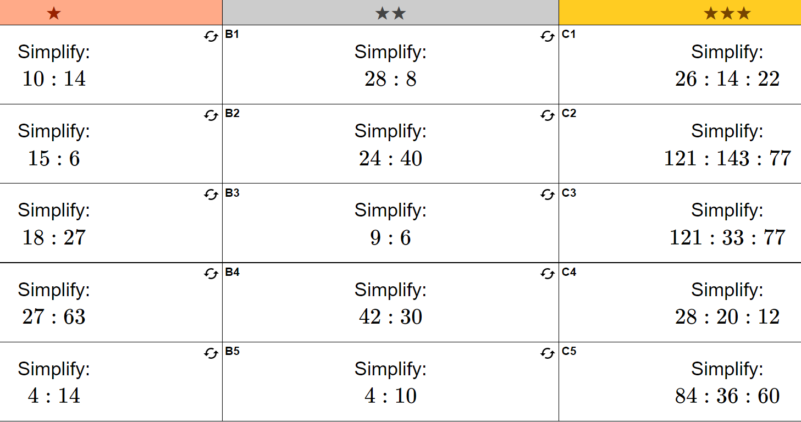

Slide 10
